Slide 1
The UK economy and Covid-19
Russell Gerrard Associate Professor in Statistics Bratislava, 18 February 2022

Slide 2
UK GDP
Impact of coronavirus
Bayes Business School (formerly Cass)

Slide 3
The UK Economy
Source: Office for National Statistics

Slide 4
The UK Economy
Source: Office for National Statistics

Slide 5
The UK Economy
Source: Office for National Statistics

Slide 6
The UK Economy
The graph on the previous page shows the strong link between hospital admissions and the GDP in the early days of Covid-19
But, as hospital admissions increased in the winter of 2020/21, the economy was less severely impacted

Slide 7
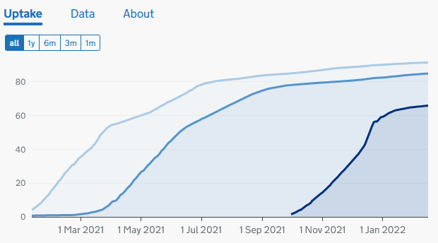
Vaccinations
Vaccination of UK adult population (%)
The UK government would like people to believe that the return to more or less normal conditions is based on vaccinations
And yet, vaccination does not really account for the difference
Source: coronavirus.data.gov.uk

Slide 8
Vaccinations and the UK Economy
The peak of new cases in the winter of 2020/21 did not have the same effect on the economy as the peak in spring 2020.
But the vaccinations had only just started by that time, so do not really explain the observations.
Sources: Office for National Statistics and coronavirus.data.gov.uk

Slide 9
Inflation
Recurrence of an old problem
Bayes Business School (formerly Cass)

Slide 10
Consumer Prices Index
Price increases have been lowest on clothes and shoes
Source: Office for National Statistics

Slide 11
Consumer Prices Index
Transport
The highest price rises are linked with Transportation.
Source: Office for National Statistics

Slide 12
Consumer Prices Index
The CPI is the weighted average of the divisional indices
Source: Office for National Statistics

Slide 13
Inflation
Now look at rates of change.
Source: Office for National Statistics

Slide 14
Inflation
CPI inflation is representative of many people’s experience
Source: Office for National Statistics

Slide 15
Monetary Policy Committee
The task of the Bank of England’s MPC is to keep inflation below 2%
Source: Office for National Statistics

Slide 16
Monetary Policy Committee
The only tool it has is the Minimum Lending Rate
Sources: Office for National Statistics and tradingeconomics.com

Slide 17
Omicron
The virus strikes back
Bayes Business School (formerly Cass)

Slide 18
Variants
Omicron rapidly became the dominant variant in the UK.
It has led to a large increase in the number of positive tests.
But the severity of the cases is less.
Source: UK Health Security Agency Technical Briefing 34

Slide 19
Variants
Over 90% of new cases are now omicron.
As it is less dangerous, it is causing less disruption to the economy.
Source: UK Health Security Agency, data for Technical Briefing 36

Slide 20
Comparisons
How does the UK compare?
Bayes Business School (formerly Cass)

Slide 21
The UK economy in comparison with others
The long-term consequences of Covid on the economy are unclear.
In 2020 the UK economy suffered worse than most from Covid-19
But it recovered strongly in 2021
Source: OECD Economic Outlook No. 110, Dec 2021

Slide 22
The UK economy in comparison with others
The long-term consequences of Covid on the economy are unclear.
In 2020 the UK economy suffered worse than most from Covid-19
But it recovered strongly in 2021
Source: OECD Economic Outlook No. 110, Dec 2021

Slide 23
Brexit
An economic disaster?
Bayes Business School (formerly Cass)

Slide 24
Predicted impact of Brexit
The OECD believed in 2016 that the impact of Brexit on the UK economy would be negative and long-lasting

Slide 25
Actual impact of Brexit
Trying to disentangle the effect of Brexit and the effect of coronavirus is difficult
The Office for Budget Responsibility has come up with an estimate of the economic impact
This is worse than the OECD’s prediction from 2016
Headline onBloomberg.com 22 Dec 2021

Slide 26
Actual impact of Brexit: reduction in EU trade
Source: the Office of Budget Responsibility

Slide 27
The future
Slowish recovery
Bayes Business School (formerly Cass)

Slide 28
The future
The OECD is optimistic about the growth potential this year and next
But the UK economy will grow more slowly than many EU countries
Source: OECD Economic Outlook No. 110, Dec 2021

Slide 29
Bayes Business School
(formerly Cass)
106 Bunhill Row
London EC1Y 8TZ
Tel + 44 (0)20 7040 8600
www.bayes.city.ac.uk

